Slide 1
A G20 INITIATIVE
Blockchain, Smart Contracts and Infrastructure

Slide 2
Blockchain, Smart Contracts and Infrastructure:
What are we Proposing?
The GI Hub is focused on developing innovative instruments to facilitate infrastructure financing.
The GI Hub is currently researching the potential application of blockchain technology and smart contracts for infrastructure transactions.
The specific concept which we are exploring is the creation of ‘tokenised interests’ in infrastructure projects.
A G20 INITIATIVE

Slide 3
What Benefits do we Hope to Achieve?
The automation of payment mechanisms eliminates the need for payment facilitators, who charge for managing the flow of money to debt investors.
Utilisation of blockchain technology will provide for more secure transactions and more accurate recordkeeping.
The increased transferability of the ‘tokenised instruments’ can provide for more efficient secondary markets.
‘Smaller ticket’ debt allocations will allow for contributions from a larger investor base, with greater diversification.
New investors, more private capital, more liquid secondary markets
A G20 INITIATIVE

Slide 4
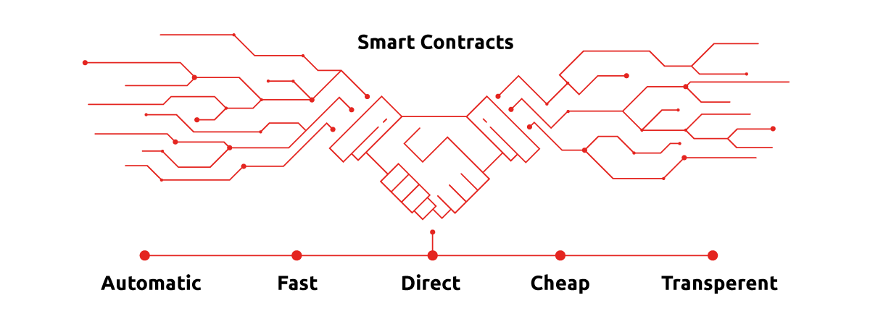
How will Smart Contracts and Blockchain Technology Facilitate What we are Proposing?
A G20 INITIATIVE

Slide 5
How Will the New Arrangements Work?
Government Project Developer
Token holder voting
Written project agreement
Issued tokens
Authorised debt
token holders
x%
Operational costs
y%
Contractual terms not digitally codified are governed by a written agreement
Debt service payments
z%
Smart contract
Equity distribution
Arranger/ intermediary
A G20 INITIATIVE
Distributed ledger

Slide 6
Some Australian Experiences
The Australian Government established a Fin Tech Advisory Board and prioritised blockchain technology.
The Australian Stock Exchange is researching replacing its electronic clearing house system (CHESS) using distributed ledger technology.
The ANZ and Westpac have worked with IBM to test using blockchain bank guarantees on commercial property leasing instead of paper guarantees.
The Commonwealth Bank (CBA) and Queensland Treasury Corporation created a government bond using blockchain.
A G20 INITIATIVE

Slide 7
Risks and Challenges
The technology is still new and evolving. This adds to the upfront costs of setting up the right structure. Attempting cross-border transactions adds additional complexities that are not well understood.
A smart contract does not replace a traditional written agreement. Instead, there is a complex interplay between the smart contract, traditional written agreements and the relevant underlying legal system.
Specific complexities exist around how a ‘tokenised instrument’ will be treated under existing financial market regulations. Again, this challenge is amplified when attempting cross-border transactions.
There is no established market for freely trading ‘tokenised instruments’.
The risks include: technological challenges; legal risks; financial regulation issues; and the absence of an established market
A G20 INITIATIVE

Slide 8
Next Steps
The GI Hub is continuing to conduct research, with a view to developing a detailed ‘White Paper’ on issuing infrastructure bonds using smart contracts.
If the initiative appears viable, the GI Hub will seek to identify qualified parties (e.g. a willing project developer and government, plus an arranger, and the required legal and technical advisors).
If successful, the GI Hub will publish the pilot’s underlying written financing agreement, and the smart contract digital coding, for replication.
If you would like to discuss this initiative with us further, please contact Mark.Moseley@GIHub.org.
A G20 INITIATIVE

